Slide 1
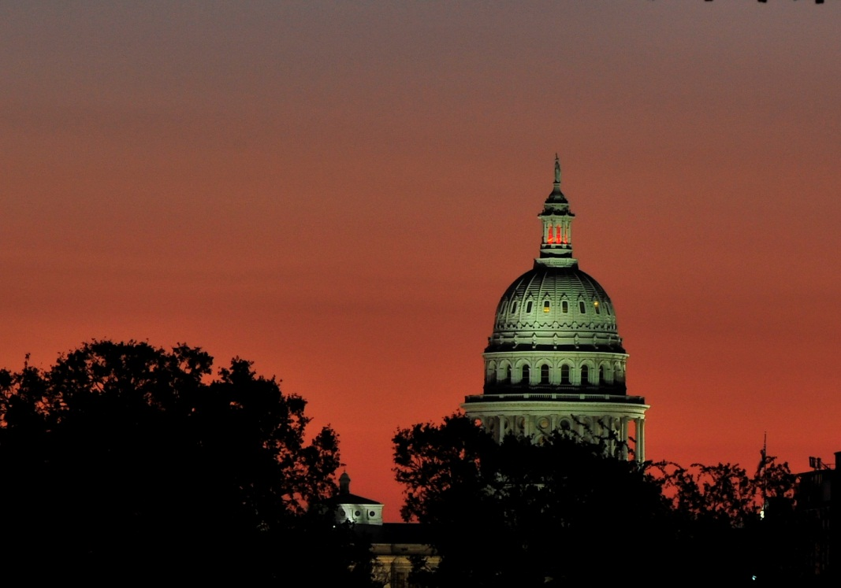
Secretary of State’s Office Update
TAEA Conference, January 2014

Slide 2
Agenda
Recap of November 5, 2013 Election
Implementation of Voter ID
Electronic Signature Capture
Introduction of Annual ABBM

Slide 3
November Uniform Election
Total Turnout: 1,139,171 votes
66% increase over 2011.

Slide 4
Implementation of Voter ID

Slide 5
What Went Right
Overall, the first statewide election under Senate Bill 14 was smooth, secure and successful.
Very few problems related to Senate Bill 14 reported to our office.
Election officials did an excellent job training poll workers!
In turn, poll workers did an excellent job of learning the new procedures and applying them at polling places.

Slide 6
SOS Office
During early voting and on election day, our office received numerous questions about Senate Bill 14, but very few complaints.
We were able to provide voters with information before they entered the polling place.
We were able to answer a number of questions from election officials before a problem occurred.

Slide 7
Election Inspectors
SOS sent 147 election inspectors across the state to 45 counties.
Inspectors reported few problems related to Voter ID.
Of the few problems reported, most related to voters not being offered provisional ballots.

Slide 8
What Needs Work
Reviewing Acceptable IDs
Procedures for Substantially Similar Names
Offering Provisional Ballots

Slide 9
Reviewing Acceptable IDs
REMEMBER:
Addresses do not have to match between ID and OLRV. Only helps voters in the “totality of the circumstances.”
Remember that some forms of acceptable identification do not have addresses, e.g. military IDs-CACs and Uniformed Services IDs.
Remember Veterans Affairs cards are acceptable!

Slide 10
Substantially Similar Name
REMEMBER:
An exact name match is not required!
Voters with substantially similar names vote a regular ballot. They do not vote provisionally.
Name change forms are optional, and not required for voting.

Slide 11
Offering Provisional Ballots
REMEMBER:
Provisional ballots need to be offered to ALL voters!!!

Slide 12
Legal Updates
Redistricting: September 5, 2013 the U.S. District Court entered an order for the plans enacted by the 83rd Legislature to be used as interim maps.
Senate Bill 14: Trial is scheduled for September 2014.

Slide 13
Electronic Signatures
H.B. 2373 (Klick): Allows for the electronic capture of a voter’s signature for the signature roster/combo form.
Texas Administrative Code Sec. 81.58
Approval Process

Slide 14
Annual ABBMs
H.B. 666 (Miller, et al): Allows voters eligible to vote early due to either disability and/or age (over 65 years old) to file an ABBM annually.
Effective January 1, 2014.

Slide 16
Reminders for the Primary
FPCA Ballots – Deadline Saturday, January 18
FPCA Forwarding Requirement
VR/EVBB Deadlines
County Chairs in Polling Place

Slide 17
Questions and Comments

